Slide 1




PYTHON UNIT 2
Python Programming: Data Collections & Functions
Master Python's powerful data structures and function-based programming concepts
Interactive Learning
Practice Problems
Exam Ready
5
25+
100%
Core Topics
Practice Questions
Coverage

Slide 2





Learning Objectives
Lists
Methods, operations, indexing, slicing, list comprehension & nesting
Tuples
5
Immutability, methods, operations, nesting & comparison with lists
Core Modules
Sets
Comprehensive Coverage
Unique elements, mathematical operations & set methods
Interactive Examples
Dictionaries
Practice Problems
Key-value pairs, methods, nesting, sorting & typecasting
Real-World Applications
Functions
Parameters, recursion, map, filter, lambda & inner functions

Slide 3




Lists: Introduction & Initialization
A mutable, ordered sequence of elements in Python
Ordered
Heterogeneous
Dynamic
Square Brackets
list() Constructor
fruits = ["apple", "banana"]
nums = list(range(5))
Using split()
Mutable: can be modified
words = "Python is awesome".split() # Returns: ["Python", "is", "awesome"]
Indexed by position
Allows duplicates

Slide 4
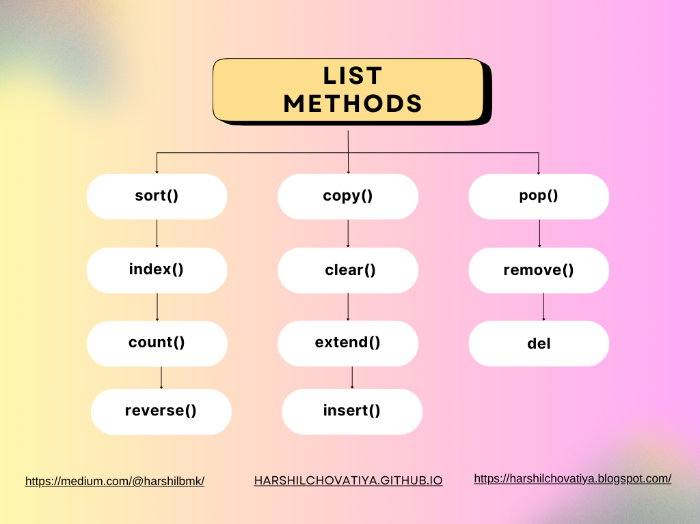

Lists: Methods & Operations
Essential List Methods
append()
Add to end
insert()
Add at index
nums.append(42)
nums.insert(0, 99)
remove()
Remove by value
pop()
Remove by index
nums.remove(42)
nums.pop() # or pop(0)
sort()
Sort list
reverse()
Reverse order
nums.sort() # ascending
nums.reverse()
sort() modifies the list in place
pop() returns the removed element
count()
Count occurrences
index()
Find index
index() raises ValueError if not found
nums.count(42)
nums.index(42)

Slide 5
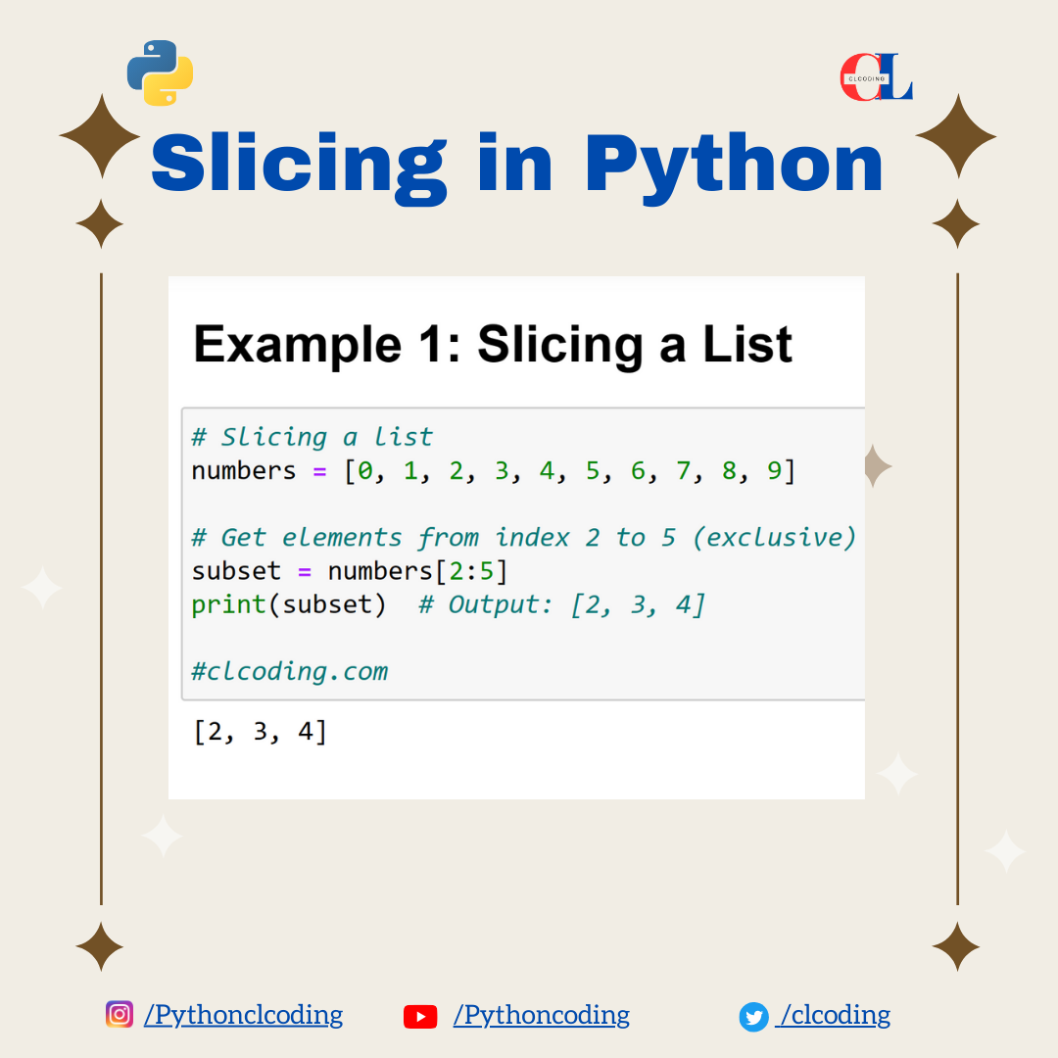


Lists: Indexing & Slicing
Positive Indexing
Negative Indexing
fruits = ["apple", "banana", "cherry"] fruits[0] → "apple" fruits[2] → "cherry"
fruits[-1] → "cherry" fruits[-3] → "apple"
Common Slicing Patterns
list[start:stop:step]
[:3]
First 3 elements
[-3:]
Last 3 elements
start
stop
step
[::2]
Every 2nd element
Include index
Exclude index
Skip elements
[::-1]
Reverse order

Slide 6
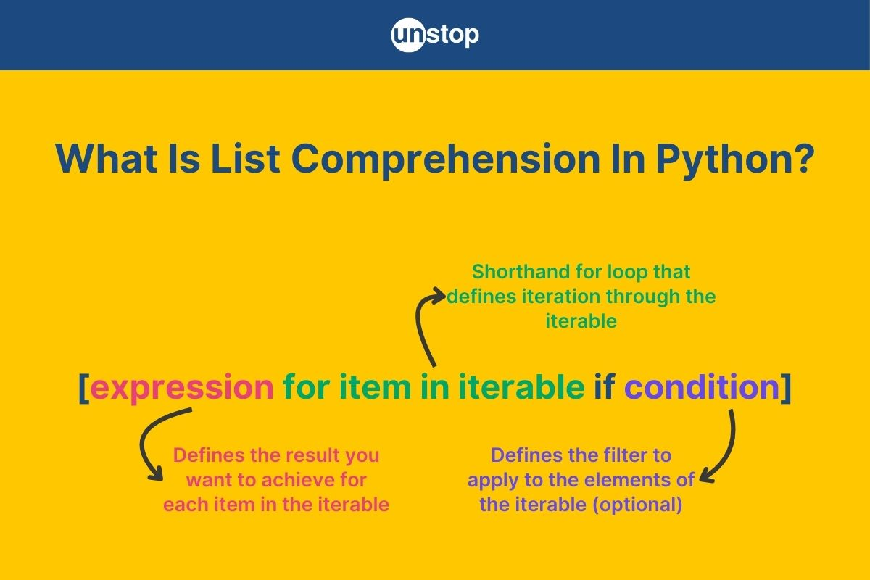




Lists: List Comprehension & Nesting
[expression for item in iterable if condition]
Traditional Way
List Comprehension
squares = [] for x in range(5): squares.append(x**2)
squares = [x**2 for x in range(5)]
matrix = [[1,2,3], [4,5,6]]
evens = [x for x in range(10) if x % 2 == 0]
uppercase = [s.upper() for s in ["a", "b", "c"]]
2D List:
matrix[0][1]
3D List:
arr[i][j][k]

Slide 7




1
List Operations
2
List Comprehension
nums = [5, 2, 8, 1] # Add 10 at end, remove 2, sort list
# Create list of squares 0-9 squares = [? for x in range(10)]
Use append(), remove(), sort()
Use x**2 in expression
3
Slicing
4
Remove Duplicates
5
Nested List
text = ["P","y","t","h","o","n"] # Slice first 3 & reverse
nums = [1,2,2,3,4,4] # Get unique elements
nested = [[1,2],[3,4]] # Flatten to single list
[:3] and [::-1]
Use set() or loop
Use nested loops
Tips for Success
Try each problem independently before checking solutions. Practice with your own examples!

Slide 8



Tuples: Introduction & Initialization
An immutable, ordered sequence of elements in Python
Cannot be modified after creation
Ordered
Heterogeneous
Immutable
Safer for fixed data
Can be used as dictionary keys
Parentheses
tuple() Constructor
coords = (10, 20)
nums = tuple(range(5))
Database records
Function return values
Single Element Tuple
Fixed configuration data
single = (42,) # Note the comma!
Geographic coordinates

Slide 9




Tuples: Methods, Operations & Nesting
nested = ( (1,2), (3,4) )
count()
index()
nums = (1,2,2,3) nums.count(2) → 2
nums = (1,2,3) nums.index(2) → 1
Access:
nested[0][1] → 2
No append()
t1 + t2
Concatenation
t * n
Repetition
No remove()
No pop()
t[i]
Indexing
t[i:j]
Slicing
No sort()
No insert()

Slide 10


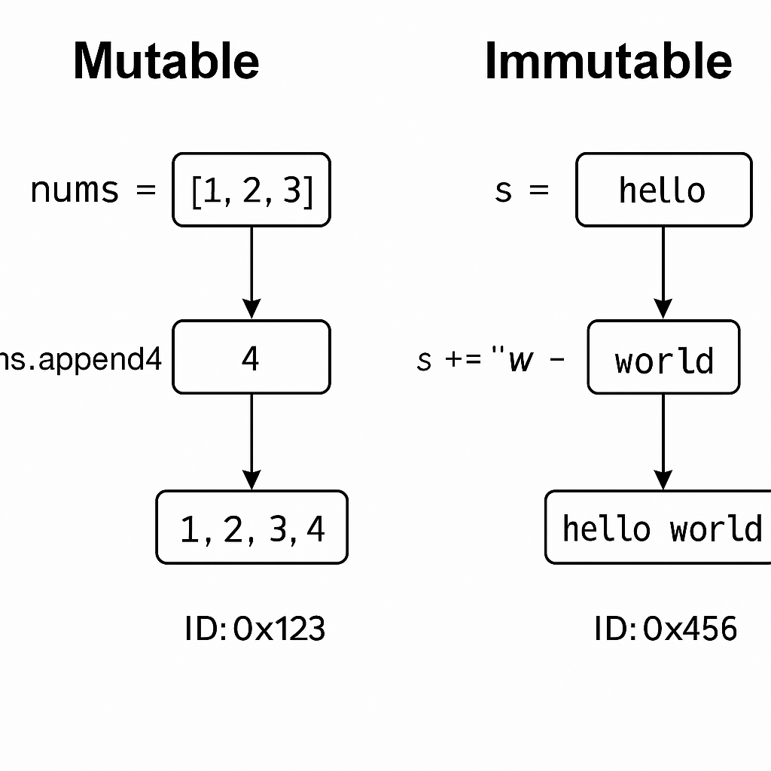










List vs Tuple Comparison
Lists
Tuples
Mutable
Immutable
Slower
Faster
More memory
Less memory
11+ methods
2 methods only
Dynamic data
Fixed data
Key Takeaway
Use Lists When:
Use Tuples When:
Tuples are faster and more memory efficient, but lists offer greater flexibility for dynamic data operations.
• Data changes frequently
• Data is constant
• Need to modify elements
• Performance critical
• Sorting required
• As dictionary keys

Slide 11

1
Access & Index
2
Tuple Methods
coords = (10, 20, 30) # Access first and last elements
nums = (1,2,2,3,2) # Count occurrences of 2
Use coords[0] and coords[-1]
Use nums.count(2)
3
Immutability
4
Nested Tuples
5
Type Conversion
nums = (1,2,3) # Try to change nums[0]
nested = ((1,2), (3,4)) # Access element 4
nums = [1,2,3] # Convert to tuple & back
Error expected!
nested[1][1]
tuple() & list()
Key Concept
Practice Tips
Tuples are immutable - once created, they cannot be modified. This makes them safer for fixed data.
Try modifying a tuple to see Python's error message. Use tuple() and list() to convert between types.

Slide 12



Sets: Introduction, Methods & Operations
A | B
Union
A & B
An unordered collection of unique elements
Intersection
No duplicates
No order
Mutable
A - B
Difference
Initialization
Modification Methods
A ^ B
s1 = {1,2,3} s2 = set(range(5))
add(), remove()
Symmetric Difference
discard(), pop()
clear()
Sets cannot contain mutable elements like lists or dictionaries. Only immutable types can be stored.

Slide 13
1
Uniqueness Property
2
Set Operations
nums = {1,2,2,3,3,4} # What will be the output?
A = {1,2,3}, B = {3,4,5} # Find A | B and A & B
Duplicates automatically removed
Use | for union, & for intersection
3
Difference
4
Subset Check
5
Remove Elements
A = {1,2,3} B = {2,3,4} # Find A - B
A = {1,2} B = {1,2,3} # Is A subset of B?
nums = {1,2,3} # Remove 2 and 3
remove() vs discard()
Elements in A but not B
Use A.issubset(B)
Key Concept
Practice Tips
Sets automatically remove duplicates and provide fast membership testing. Perfect for unique data!
Remember that sets are unordered. The output may vary in display but the content remains the same.

Slide 14






Dictionaries: Introduction & Initialization
An unordered collection of key-value pairs
Data Storage
Mutable
Unique keys
Fast lookup
Student records, configs
Lookup Tables
Fast key-based access
Curly Braces
dict() Constructor
Frequency Counting
Word counts, stats
student = { "name": "John", "age": 20 }
scores = dict( math=95, sci=88 )
API Responses
JSON data handling
Key Characteristics
Dictionary keys must be immutable (strings, numbers, tuples). Lists cannot be used as keys.
Unique Keys
Immutable Keys
Unordered
No duplicates
Strings, numbers
No index

Slide 15

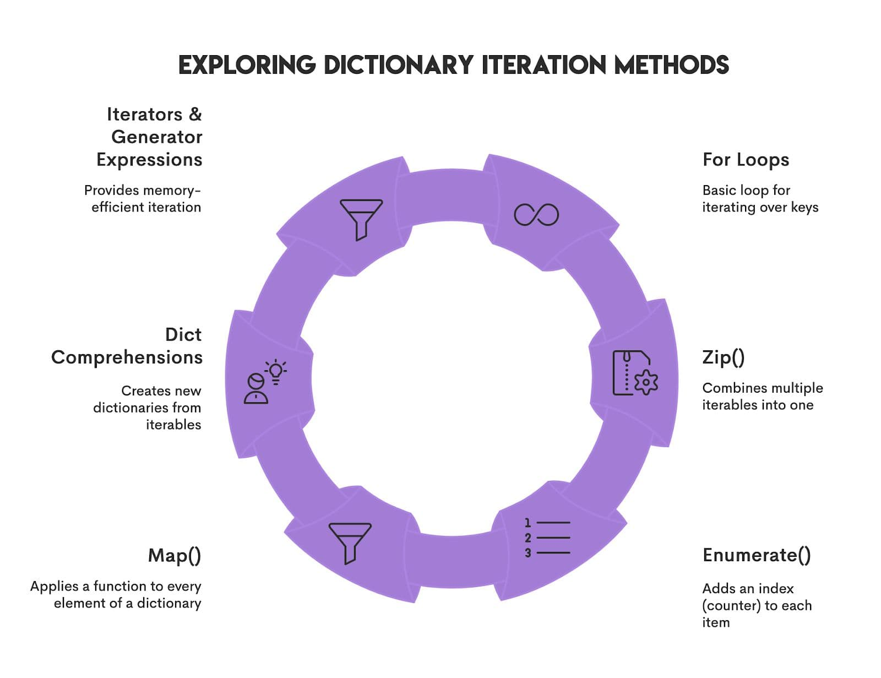






Dictionaries: Methods, Nesting & Operations
.get(key, default)
.keys()
Safe value access
Get all keys
.values()
.items()
Get all values
Get key-value pairs
students = { "class": { "101": {"name": "John"}, "102": {"name": "Jane"} } }
dict[key] = value
Add/update
del dict[key]
Remove key
for key, val in d.items():
Iterate
.update(other_dict)
Merge dict
Access:
students["class"]["101"]["name"]

Slide 16




Sorting & Typecasting in Collections
nums.sort()
Sorting Examples
Sorts list in place
List Sorting
nums = [3,1,4,1,5] nums.sort() → [1,1,3,4,5]
sorted(nums)
Returns new sorted list
Reverse Sorting
nums.sort(reverse=True)
sorted(dict.items())
Sort dict by keys
Sort by Value
sorted(scores, key=scores.get)
In-place Sort
New List
tuple([1,2,3]) → (1,2,3) list({1,2,3}) → [1,2,3] list(dict.items()) → [(k,v),...]
Modifies original
Keeps original

Slide 17





1
Access & Modify
2
Dictionary Methods
student = {"name": "John", "age": 20} # Add grade and update age
scores = {"math": 95, "sci": 88} # Get all keys and values
3
Nested Dictionary
4
Sort Dictionary
5
Type Conversion
# Create nested dict
# Sort by values
# Convert to list of tuples
d1 = {"a":1,"b":2} d2 = {"b":3,"c":4}
Merge dictionaries using update()
d1.update(d2)
Use get() for safe access
Keys must be unique
Iterate with items()

Slide 18








Functions: Introduction & Advantages
A reusable block of code that performs a specific task when called
Reduced code duplication
Better organization
Reusability
Readability
Easier maintenance
Write once, use many times
Clearer, cleaner code
Improved collaboration
Modularity
Easier Debugging
Break complex tasks
Isolate and fix issues
When code is repeated multiple times, when breaking down complex problems, or when creating reusable utilities
def greet(name): print("Hello, " + name + "!") greet("Alice") # Output: Hello, Alice!

Slide 19





Functions: Parameters & Documentation
def calculate_area(length, width): """ Calculate the area of a rectangle. Parameters: length (float): Length of the rectangle width (float): Width of the rectangle Returns: float: Area of the rectangle Example: >>> calculate_area(5, 3) 15 """ return length * width
Positional Parameters
def add(a, b): # a and b must be provided in order
Keyword Parameters
add(a=1, b=2) # Clear and explicit
Use triple quotes
Describe purpose
List parameters
Explain returns
Include examples
Keep it concise
Access Docstring
IDE Support
function_name.__doc__
Most IDEs show docstrings on hover

Slide 20







Functions: Keyword, Optional & Default Parameters
Clearer Code
Named arguments improve readability
def student_info(name, age, grade): print(f"{name} is {age} in grade {grade}")
Order Independence
Skip positional requirements
Positional: student_info("John", 18, 12)
Flexibility
Keyword: student_info(name="John", age=18)
Default values make parameters optional
def greet(name, greeting="Hello"): print(f"{greeting}, {name}!") greet("Alice") # Output: Hello, Alice! greet("Bob", "Hi") # Output: Hi, Bob!
Defaults first
Keyword clarity
Mix wisely
Document defaults
Remember: Always position parameters with defaults after regular parameters

Slide 21


Functions: Variable Length Arguments & Scope
Local Scope
Global Scope
def sum_all(*args): return sum(args) sum_all(1, 2, 3) # Output: 6
Variables inside function
Variables outside function
L
Local
E
Enclosing
Function's own variables
Outer function's scope
def student_data(**kwargs): for key, value in kwargs.items(): print(f"{key}: {value}") student_data(name="John", age=18)
G
Global
B
Built-in
Module-level scope
Python built-in scope
Remember: Python searches for variables in this order: Local → Enclosing → Global → Built-in

Slide 22




Functions: Passing Collections & Recursion
def modify_list(lst): lst.append(99) # Changes original! nums = [1, 2, 3] modify_list(nums) print(nums) # [1, 2, 3, 99]
def factorial(n): # Base case if n == 1: return 1 # Recursive case return n * factorial(n - 1)
Base Case
Recursive Case
Stops recursion
Calls itself
Mutable Types
Immutable Types
Iterative
Recursive
lists, dicts, sets
numbers, strings, tuples
Passed by reference
Passed by value
Faster, uses loops
Elegant, uses stack

Slide 23




Advanced Functions: map, filter, lambda, inner functions
numbers = [1, 2, 3] squared = list(map(lambda x: x**2, numbers)) # Output: [1, 4, 9]
evens = list(filter(lambda x: x % 2 == 0, numbers)) # Output: [2]
square = lambda x: x ** 2 # Or directly: result = (lambda x, y: x + y)(5, 3)
def outer(x): def inner(y): return x * y return inner # Closure preserves x value
Single Expression
Used with map/filter
Anonymous, concise
Short-lived functions

Slide 24

Practice Questions - Functions
1
Function with Parameters
5
filter with lambda
Write a function calculate_circle(radius) that returns area and circumference. Use keyword arguments.
Filter numbers greater than 5 using filter() and lambda.
6
Inner Functions
2
Default Arguments
Create an outer function that returns an inner function demonstrating closure.
Create greet(name, greeting="Hello"). Call it with and without the greeting parameter.
7
Passing Lists
3
Recursion: Factorial
Write a function that modifies a passed list. Demonstrate it affects the original list.
Implement factorial recursively. Include base case and recursive case.
4
map with lambda
8
Scope Demonstration
Use map() and lambda to convert list of strings to uppercase.
Show the difference between local and global variables with examples.
Practice Tips: Always start with a simple implementation, then add complexity. Use docstrings to document your functions. Test with different inputs!

Slide 25








Summary & Key Takeaways
Lists
Tuples
Sets
Dictionaries
Functions
Mutable
Immutable
Unique
Key-Value
Reusable
Lists: append, pop, sort, slicing
Tuples: count, index, faster
Practice regularly with different problems
Sets: union, intersection, difference
Dicts: keys, values, items, get
Understand concepts, don't just memorize
Funcs: def, return, *args, **kwargs
Adv: map, filter, lambda, recursion
Solve practice questions from each section
Review code examples and try variations
Keep Learning
Practice Makes Perfect
Next Steps
Python has powerful built-in collections. Master them to write efficient code!
Build projects using collections and functions to reinforce learning.
Explore advanced topics like decorators, generators, and class methods.

